Slide 1

Relay Overcurrent Protection Simulation
Zane Richards & Nate Fischer
November 20, 2025

Slide 2
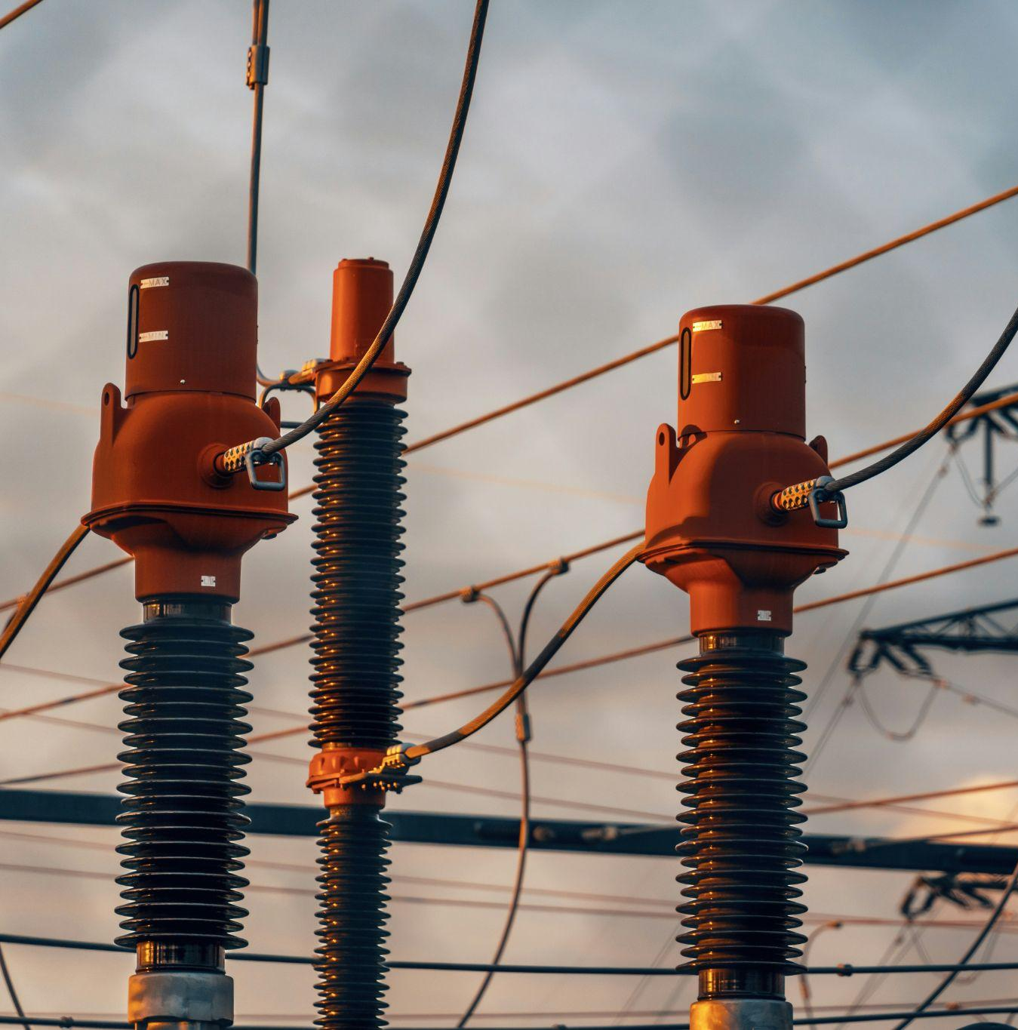
Why Grid Protection Matters
The electrical grid needs protection because faults happen:
Short circuits, trees touching lines, equipment failure, etc.
Faults cause very large currents which can:
Damage equipment
Cause fires
Create large blackouts
Protection systems detect abnormal electrical conditions and disconnect the damaged part of the system.

Slide 3

11/20/2025
Project Goal & Scope
Model a 13.8kV Feeder With Faults
MATLAB Simulation
Analyze Relay Operation for 3 Fault Types
Research

Slide 4
System Overview
Overcurrent Relay
Current Transformer
Feeder
The system that is being simulated
Part of the power distribution system that carries electricity from a substation to neighborhoods, businesses, etc.
The “main branch” of a local distribution grid
First line of defense in feeder systems
Circuit breaker with a brain
Instantly breaks the circuit if there is an extreme fault
Waits a set amount of time before breaking the circuit if there is a non-extreme abnormality
Power lines carry hundreds to thousands of amps
Current transformers scale down current so that it can be measured
The relay uses the CT output (secondary) to make decisions

Slide 5

Feeder
Current Transformer
Fault Point
Fault Point
Feeder
Current Transformer
Fault Point
Relay

Slide 6
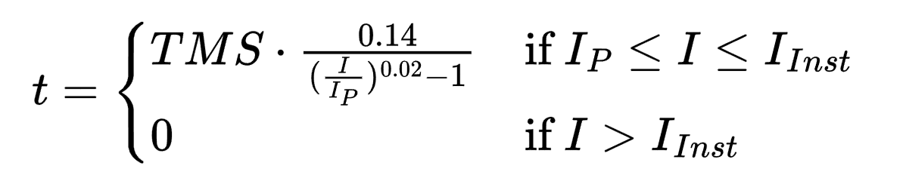
Relay Operation Logic
Reads current from the CT secondary side (stepped down current)
Instantly trips and breaks the circuit if there is an extreme abnormality
Waits a period before breaking if there is an abnormality that may not be a fault
Time is determined using IEC Standard Inverse Curve

Slide 7
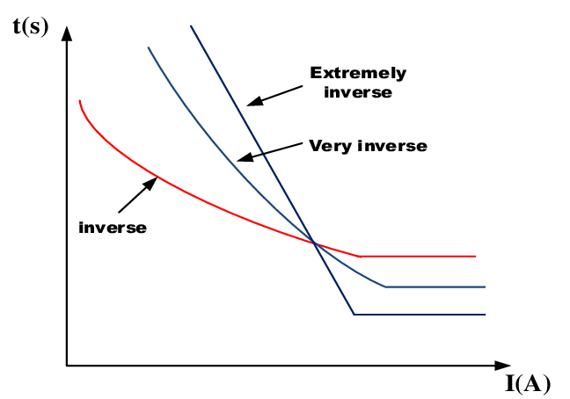

Slide 8
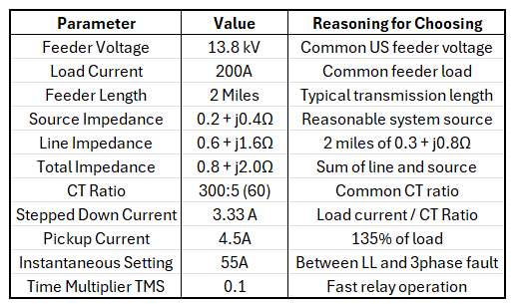
Chosen System Parameters

Slide 9
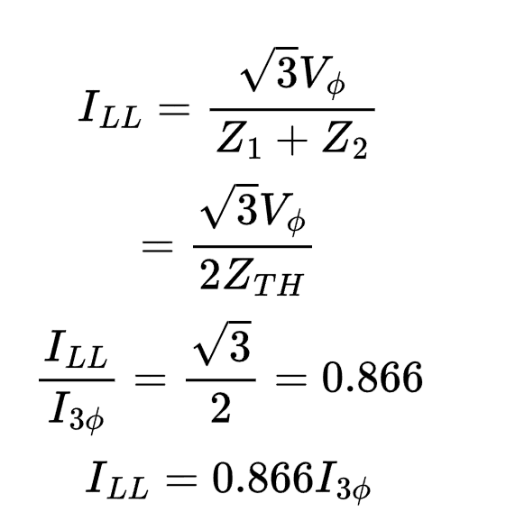
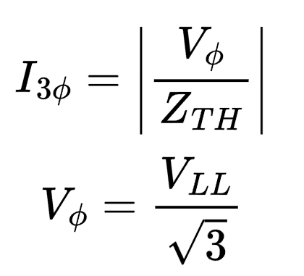
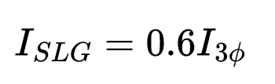
Fault Current Calculations
3 Phase Fault
Line to Line Fault
Line to Ground Fault
All 3 phases are shorted together
Two lines touch
(2 phase fault)
A single line touches the ground, much more complex to calculate
Values typically range from 0.5-0.7x the 3 Phase Fault Current

Slide 10
MATLAB Simulation overview
Input key parameters (feeder voltage, CT ratio, breakpoint currents, etc.)
Compute fault currents (both regular and stepped down values)
Generate a time-current curve based on the IEC formula
Analyze relay behavior and trip times

Slide 11
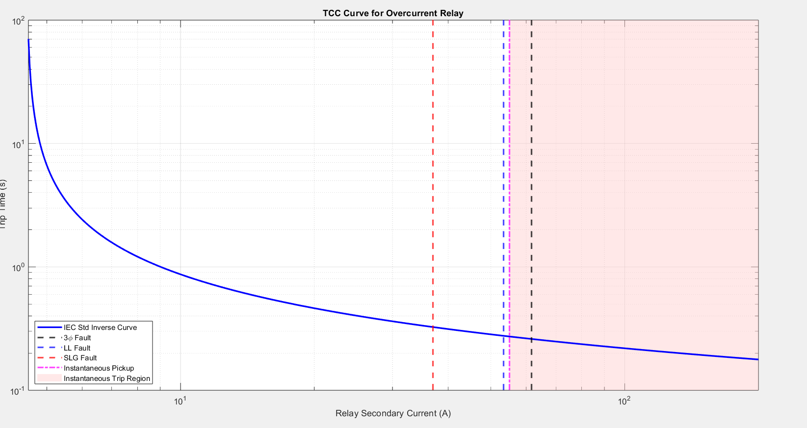

Slide 12
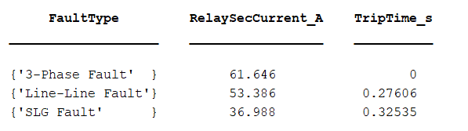

Slide 13
Interpretations & Limitations
Our simulation behaves realistically
Extreme faults clear instantly, weaker faults clear with delay to reduce miscoordination
Line-to-Line and SLG faults were approximated
No transient modeling or DC offset implementation
Only models the initial circuit break and does not consider reclosing

Slide 14
Possible Improvements
Apply coordination with downstream devices
1
Simulate recloser curves
2
Improve calculations of fault currents
3
Compare IEC vs. IEEE curves
4

